Slide 1
WHY sean should be team rep
source: trust
Sean (Zhi Yuan) Yin
Inspired by Vanessa Xu and Nicholas Germain

Slide 2
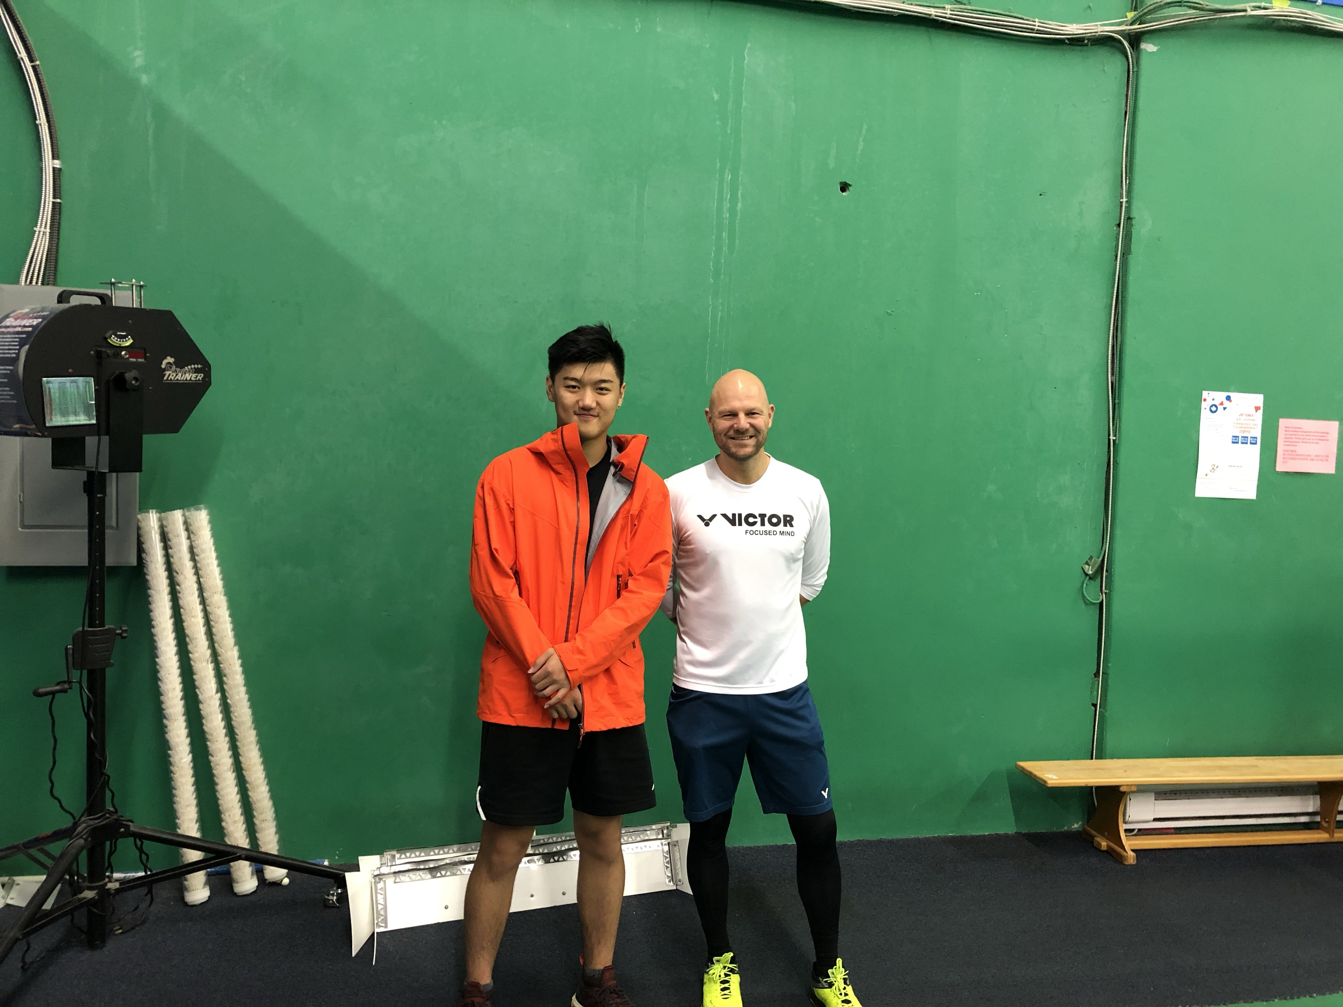
Introduction
Born in Beijing, I live in BC, and then came to McGill to study
I have been playing badminton since grade 7, but only started training in grade 10
I can speak mandarin and English
U2 in Psychology (I know what you’re thinking all the time)

Slide 3
PRIMARY GOALS
What I want to accomplish if I get elected

Slide 4
Yearly PERFORMANCE

Slide 5
#1
Make badminton more fun and get more recognition within the McGill community
It’s not just a backyard activity, it is a very competitive sport
Ex. making sure our team gets to play on the same playing field with the rest of the varsity teams

Slide 6
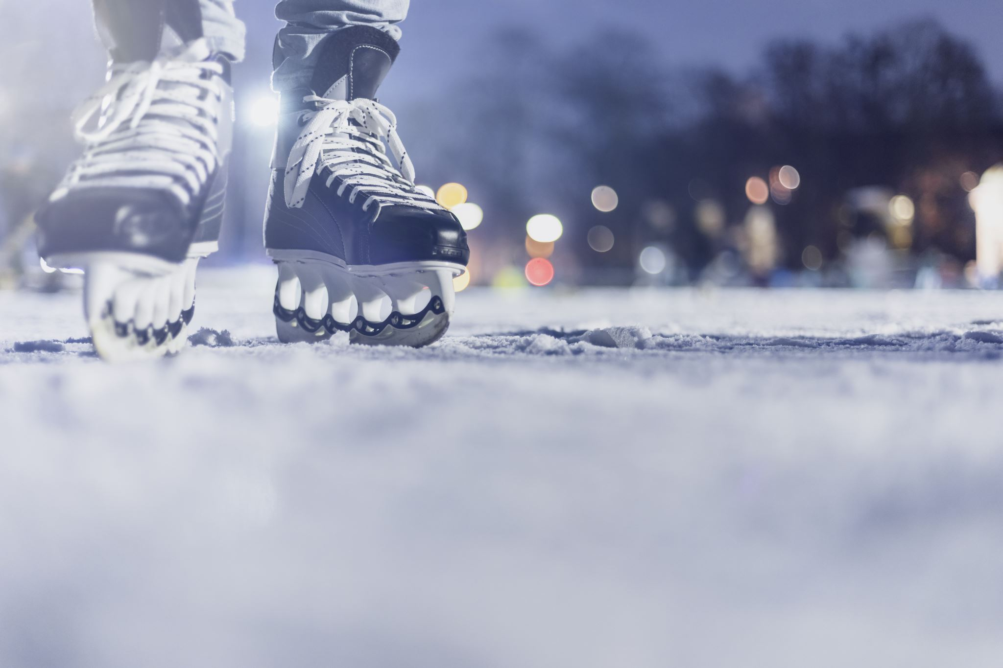
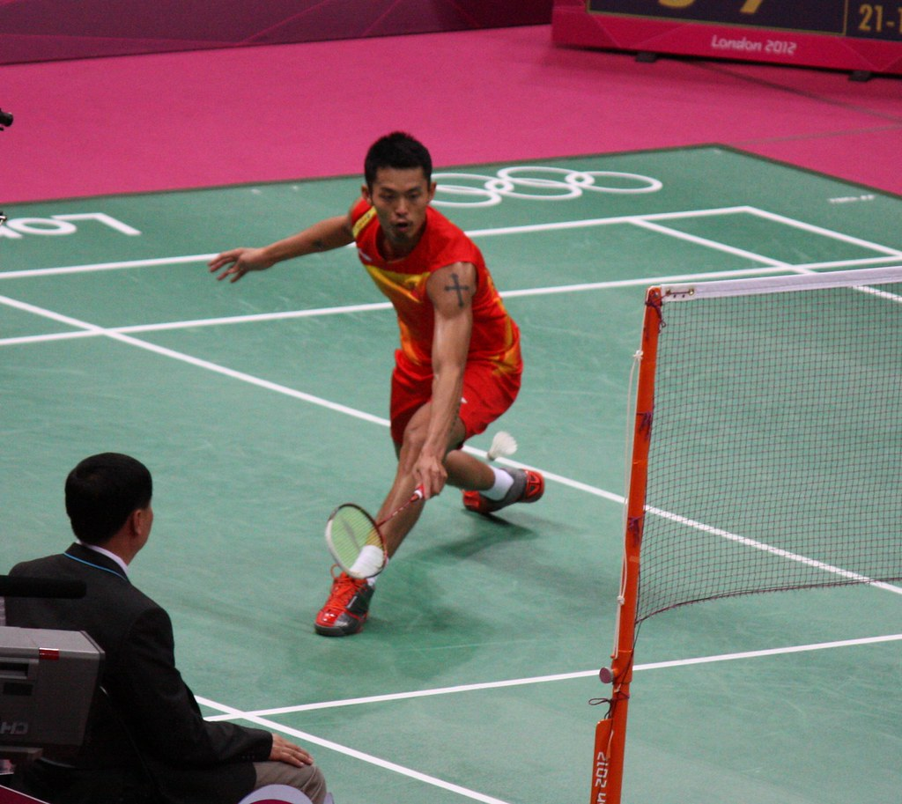
#2
what we want
Funding to help improve training conditions and quality of training
Ex. Improving the courts and nets in order to improve our consistency and overall skills as a player

Slide 7
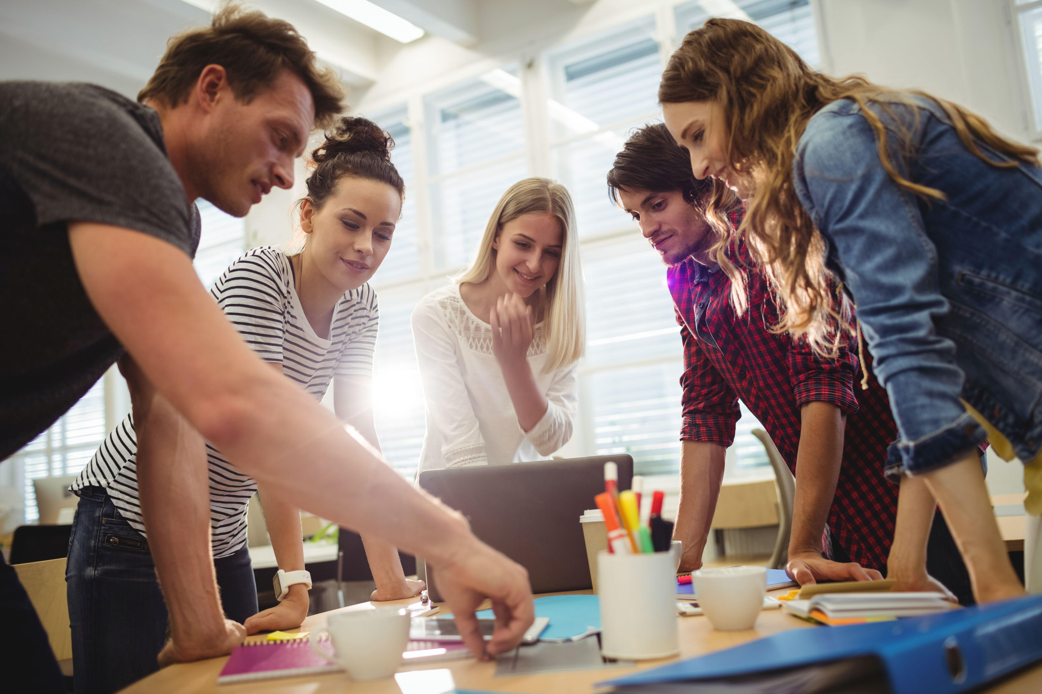
#3
Include and encourage everyone to contribute creative ideas in order to make our varsity badminton experience the best

Slide 8
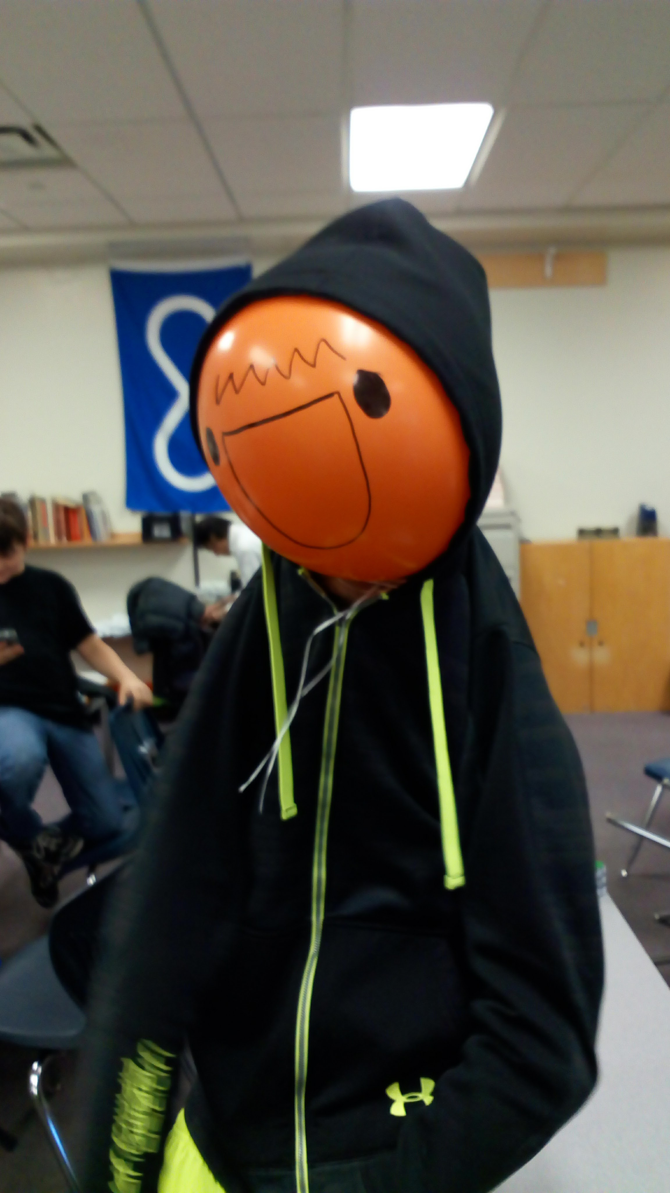
THANK YOU!!!

